Slide 1
Unit - III
Digital Marketing Planning and Setup

Slide 2
Digital Marketing Communications and Channel Mix
Digital Marketing Planning Development
The Media Planning Shift to Digital
Media channel
Media vehicle
Media audience
Media schedule
Media budget
Media delivery

Slide 3
Marketing shift (from outbound to inbound)
Pricing shift (from premium to targeted)
Impact of programmatic (from human to algorithmic)
Fragmented channels (from loyalists to disengaged)
Follow the data (from analytics to big data)

Slide 4
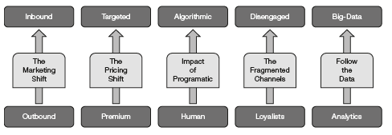

Slide 5
Understanding Digital Media Planning Terminology
Effectiveness of media channel
ROI of communication/promotion on that media

Slide 6
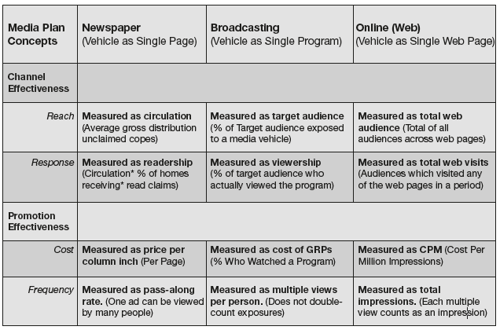

Slide 7
Key Digital Planning Concepts
Web visits
Page visits
Unique visitors
Impressions
Page views
Clicks
Click-through
CPM (cost-per-thousand)
CPC (cost per click)
CPA (cost per action)

Slide 8
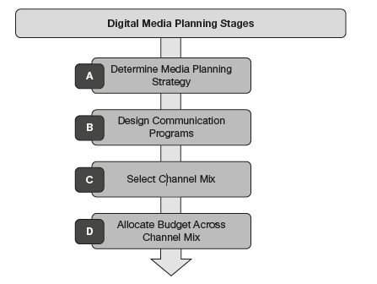
Digital Media Planning Stages

Slide 9
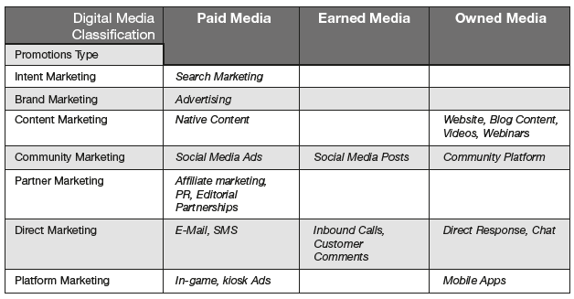
Digital Media Classification of Promotion Types

Slide 10
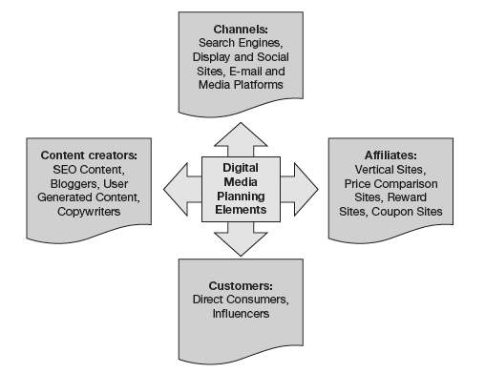
Core Elements of Digital Media Planning

Slide 11
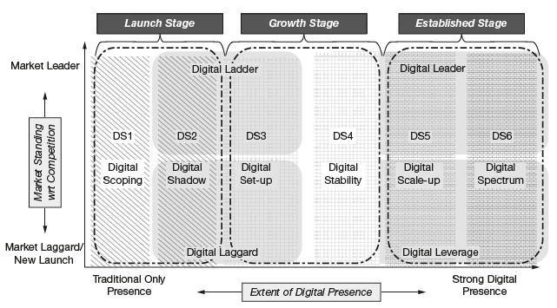
6S Digital Marketing Implementation Groups

Slide 12
Allocate Budget across Channel Mix
Affordable method
Percentage of sales method
Competitive parity method
Objective and task method

Slide 13
Investment Analysis and Planning for Marketing RoI
ROI = {(Net Present Value of Profits & Expenses) –Investment} /Investment
Customer Lifetime Value (CLV)
Total number of customers
Marketing expense

Slide 14
The Marketo Group (one of the top digital marketing product companies) has devised a three-step process to plan for marketing RoI.
Establishing targets and RoI estimates
Designing measurable programs
Marketing improvement decisions

